Slide 1
Decision Trees (Wrap-up) and Linear Models
CS771: Introduction to Machine Learning
Piyush Rai

Slide 2
Plan for today
Wrap-up the discussion of decision trees
How to learn decision trees from training data
Introduction to Linear Models

Slide 3





Constructing Decision Trees
Given some training data, what’s the “optimal” DT?
5
How to decide which rules to test for and in what order?
NO
YES
$$x_{1}>3.5 ?$$
4
NO
YES
NO
YES
How to assess informativeness of a rule?
3
$$x_{2}>2 ?$$
$$x_{2}>3 ?$$
Feature 2 ($x_{2})$
2
Predict Red
Predict Green
Predict Green
Predict Red
1
In general, constructing DT is an intractable problem (NP-hard)
1
2
3
4
5
6
Feature 1 ($x_{1})$
The rules are organized in the DT such that most informative rules are tested first
Often we can use some “greedy” heuristics to construct a “good” DT
Hmm.. So DTs are like the “20 questions” game (ask the most useful questions first)
To do so, we use the training data to figure out which rules should be tested at each node
Informativeness of a rule is of related to the extent of the purity of the split arising due to that rule. More informative rules yield more pure splits
The same rules will be applied on the test inputs to route them along the tree until they reach some leaf node where the prediction is made

Slide 4
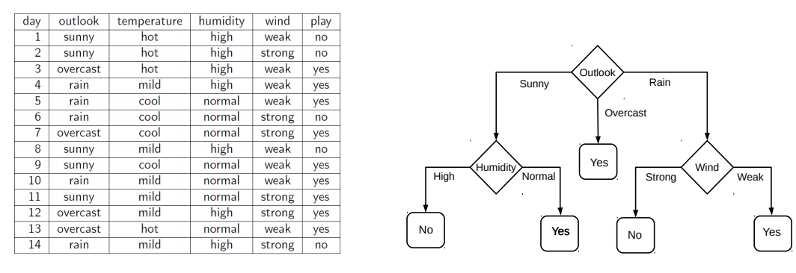
Decision Tree Construction: An Example
4
Let’s consider the playing Tennis example
Assume each internal node will test the value of one of the features
Question: Why does it make more sense to test the feature “outlook” first?
Answer: Of all the 4 features, it’s the most informative
It has the highest information gain as the root node

Slide 5
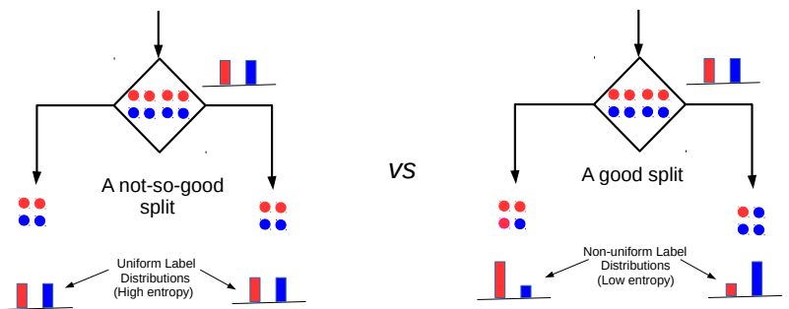


Entropy and Information Gain
5
Assume a set of labelled inputs $S$ from C classes, $p_{c}$ as fraction of class c inputs
Entropy of the set $S$ is defined as $H(S)=−\sum_{c∈C}{p_{c} log p_{c}}$
Suppose a rule splits $S$ into two smaller disjoint sets $S_{1}$ and $S_{2}$
Reduction in entropy after the split is called information gain
Uniform sets (all classes roughly equally present) have high entropy; skewed sets low
$IG=H\left(S\right)− \frac{\left|S_{1}\right|}{\left|S\right|}H\left(S_{1}\right)$ $− \frac{\left|S_{2}\right|}{\left|S\right|}H\left(S_{2}\right)$
This split has a low IG
(in fact zero IG)
This split has higher IG

Slide 6
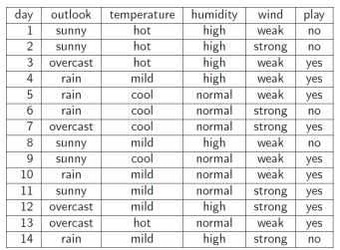
Entropy and Information Gain
6
Let’s use IG based criterion to construct a DT for the Tennis example
At root node, let’s compute IG of each of the 4 features
Consider feature “wind”. Root contains all examples S = [9+,5-]
S_{weak} = [6+, 2−] ⇒ H(S_{weak} ) = 0.811
S_{strong} = [3+, 3−] ⇒ H(S_{strong}) = 1
Likewise, at root: IG(S, outlook) = 0.246, IG(S, humidity) = 0.151, IG(S,temp) = 0.029
Thus we choose “outlook” feature to be tested at the root node
Now how to grow the DT, i.e., what to do at the next level? Which feature to test next?
Rule: Iterate - for each child node, select the feature with the highest IG
$$\text{H}\text{(}\text{S} \text{) =}\text{ −(9/14) }\text{log}\text{2}\text{(9/14) − (5/14) }\text{lo}\text{g}\text{2}\text{(5/14) = 0.94}$$
$IG(S,wind)=H\left(S\right)− \frac{\left|S_{weak}\right|}{\left|S\right|}H\left(S_{weak}\right)$ $− \frac{\left|S_{strong}\right|}{\left|S\right|}H\left(S_{strong}\right)$ = 0.94 − 8/14 ∗ 0.811 − 6/14 ∗ 1 = 0.048

Slide 7
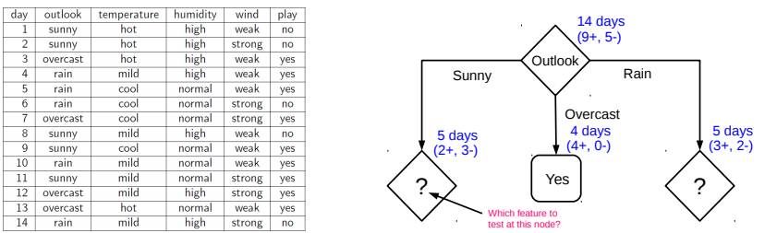
Growing the tree
7
Proceeding as before, for level 2, left node, we can verify that
IG(S,temp) = 0.570, IG(S, humidity) = 0.970, IG(S, wind) = 0.019
Thus humidity chosen as the feature to be tested at level 2, left node
No need to expand the middle node (already “pure” - all “yes” training examples ☺)
Can also verify that wind has the largest IG for the right node
Note: If a feature has already been tested along a path earlier, we don’t consider it again

Slide 8
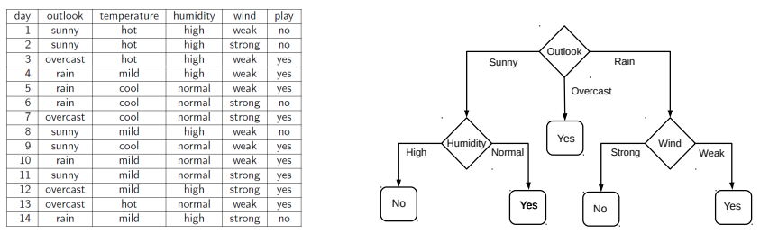
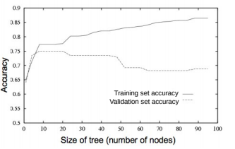
When to stop growing the tree?
8
Stop expanding a node further (i.e., make it a leaf node) when
It consist of all training examples having the same label (the node becomes “pure”)
We run out of features to test along the path to that node
The DT starts to overfit (can be checked by monitoring
the validation set accuracy)
Important: No need to obsess too much for purity
It is okay to have a leaf node that is not fully pure, e.g., this
At test inputs that reach an impure leaf, can predict probability of belonging to each class (in above example, p(red) = 3/8, p(green) = 5/8), or simply predict the majority label
To help prevent the tree from growing too much!
OR

Slide 9
Avoiding Overfitting in DTs
9
Desired: a DT that is not too big in size, yet fits the training data reasonably
Note: An example of a very simple DT is “decision-stump”
A decision-stump only tests the value of a single feature (or a simple rule)
Not very powerful in itself but often used in large ensembles of decision stumps
Mainly two approaches to prune a complex DT
Prune while building the tree (stopping early)
Prune after building the tree (post-pruning)
Criteria for judging which nodes could potentially be pruned
Use a validation set (separate from the training set)
Prune each possible node that doesn’t hurt the accuracy on the validation set
Greedily remove the node that improves the validation accuracy the most
Stop when the validation set accuracy starts worsening
Use model complexity control, such as Minimum Description Length (will see later)
Either can be done using a validation set

Slide 10
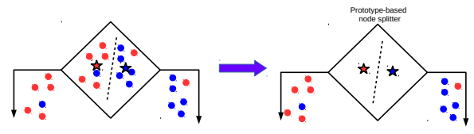
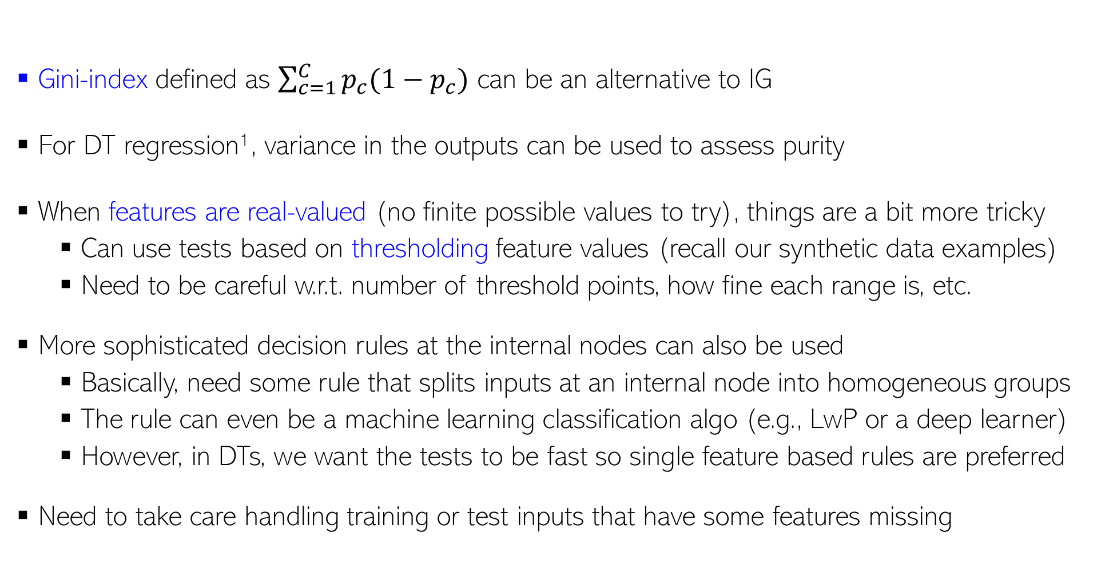
Decision Trees: Some Comments
For regression, outputs are real-valued and we don’t have a “set” of classes, so quantities like entropy/IG/gini etc. are undefined
10
Gini-index defined as $\sum_{c=1}^{C}{p_{c}(1−p_{c})}$ can be an alternative to IG
For DT regression¹, variance in the outputs can be used to assess purity
When features are real-valued (no finite possible values to try), things are a bit more tricky
Can use tests based on thresholding feature values (recall our synthetic data examples)
Need to be careful w.r.t. number of threshold points, how fine each range is, etc.
More sophisticated decision rules at the internal nodes can also be used
Basically, need some rule that splits inputs at an internal node into homogeneous groups
The rule can even be a machine learning classification algo (e.g., LwP or a deep learner)
However, in DTs, we want the tests to be fast so single feature based rules are preferred
Need to take care handling training or test inputs that have some features missing
An illustration on the next slide
¹Breiman, Leo; Friedman, J. H.; Olshen, R. A.; Stone, C. J. (1984). Classification and regression trees

Slide 11
An Illustration: DT with Real-Valued Features
11
Test example
“Best” (purest possible) Horizontal Split
“Best”(purest possible) Vertical Split
Up Down
Left Right
Between the best horizontal vs best vertical split, the vertical split is better (more pure), hence we use this rule for the internal node
This illustration’s credit: Purushottam Kar

Slide 12
Decision Trees: A Summary
12
.. thus helping us learn complex rule as a combination of several simpler rules
Some key strengths:
Simple and easy to interpret
Nice example of “divide and conquer”
paradigm in machine learning
Easily handle different types of
features (real, categorical, etc.)
Very fast at test time
Multiple DTs can be combined
via ensemble methods: more powerful
(e.g., Decision Forests; will see later)
Used in several real-world ML applications, e.g., recommender systems, gaming (Kinect)
Some key weaknesses:
Learning optimal DT is (NP-hard) intractable. Existing algos mostly greedy heuristics
Can sometimes become very complex unless some pruning is applied
5
NO
YES
$$x_{1}>3.5 ?$$
4
NO
YES
NO
YES
3
$$x_{2}>2 ?$$
$$x_{2}>3 ?$$
Feature 2 ($x_{2})$
2
Predict Red
Predict Green
Predict Green
Predict Red
1
1
2
3
4
5
6
Human-body pose estimation
Feature 1 ($x_{1})$

